Slide 1
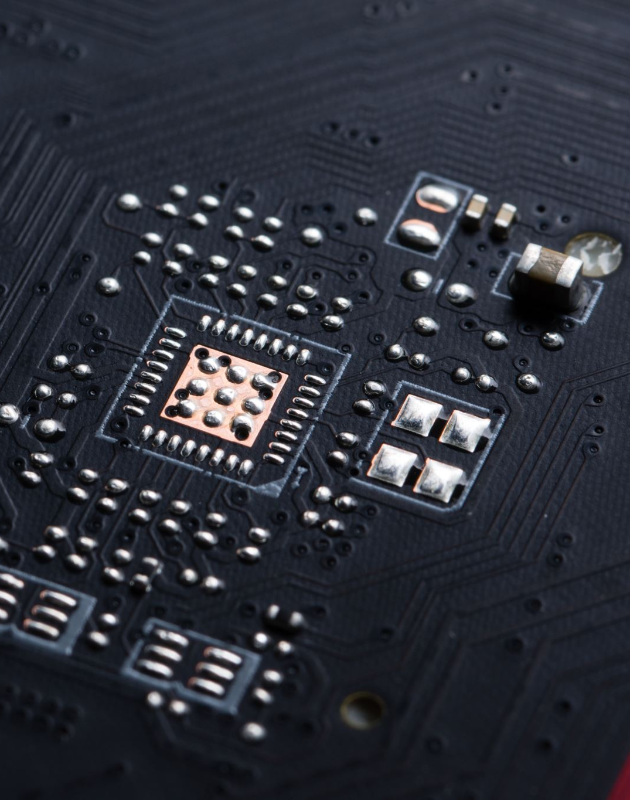
New Video Processor Proposal
Bailey Smith

Slide 2
Current Processor
LOOP:
Read 1 frame.
Crop the frame.
Binary threshold the image based on the levels of green.
Dilate > Erode > Dilate.
Find contours and then the contour area.
Draw contour on frame.
Spray

Slide 3
Problems with the current processor
1) Sprays the same weed multiple times.
This results in a large spray volume.
2) Does not slow down to spray.
This results in a large spray area.
3) Cannot differentiate between crops and weeds.
This means the navigation has zero margin for error.

Slide 4
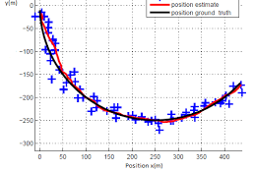
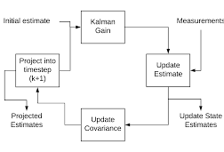
Refresher
Kalman Filter

Slide 5
Proposed Processor
Keep the current processor but with additions.
Use a Kalman Filter to track the weeds as they travel through the screen.
Allows us to predict when the robot will be aligned with a weed.
Weed instances persist through frames so we know not to spray them twice.
Adjust the robots speed to stop on each weed.

Slide 6
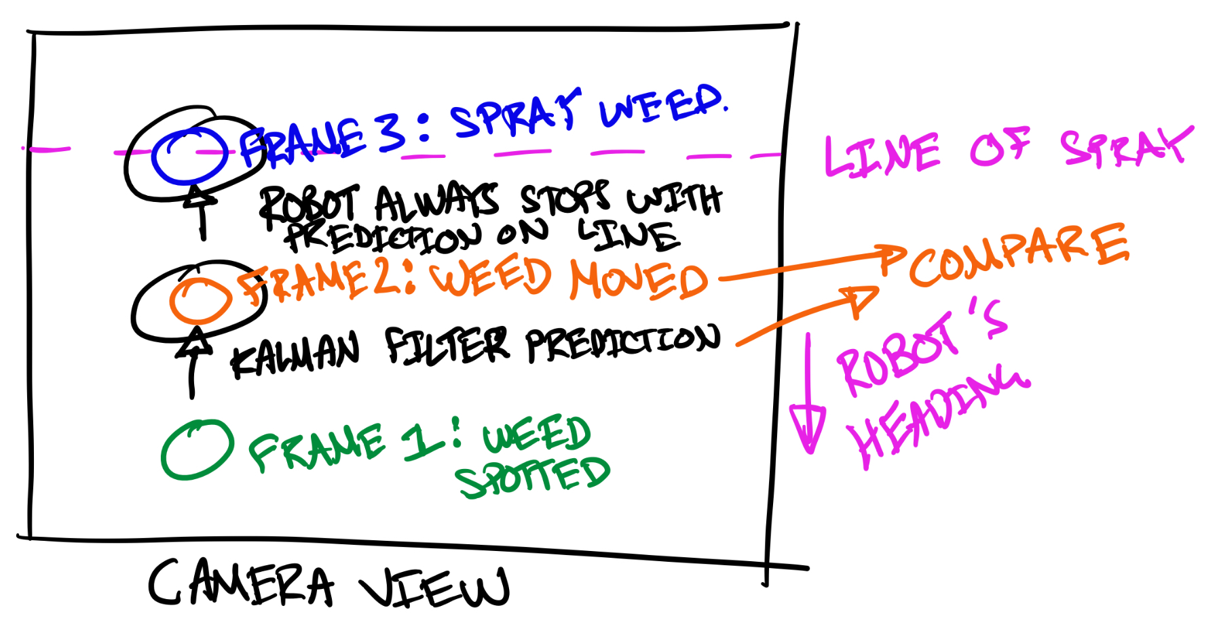
Proposed Processor (2)

Slide 7
What does this achieve?
SOLVES problem 1: Sprays the same weed multiple times.
SOLVES problem 2: Does not slow down to spray.
DOES NOT SOLVE problem 3: Cannot differentiate between crops and weeds.

Slide 8
Development
I have created a file that modifies the current processor file to run videos from a laptop and display the results.
Implement Kalman Filter on each weed and compare each frame.
Modify the file to draw ellipses in different colours if they have been:
Seen in a previous frame.
“Sprayed”
Evaluate the performance.
Integrate within the system.
Control the speed so that the robot stops on a weed.
Control the spraying so that it only sprays each weed once.

Slide 9
Potential Limitations
Doesn’t solve problem 3: Cannot differentiate between crop rows and weeds.
The time complexity of the Kalman filter for each weed.
I am not sure how slow this algorithm is. There is a possibility it could slow down the frame rate of the processor too much.
Not enough data for development.
We need to go out into the field and get more videos with the crops in a different condition.

Slide 10

Questions?

